Slide 1
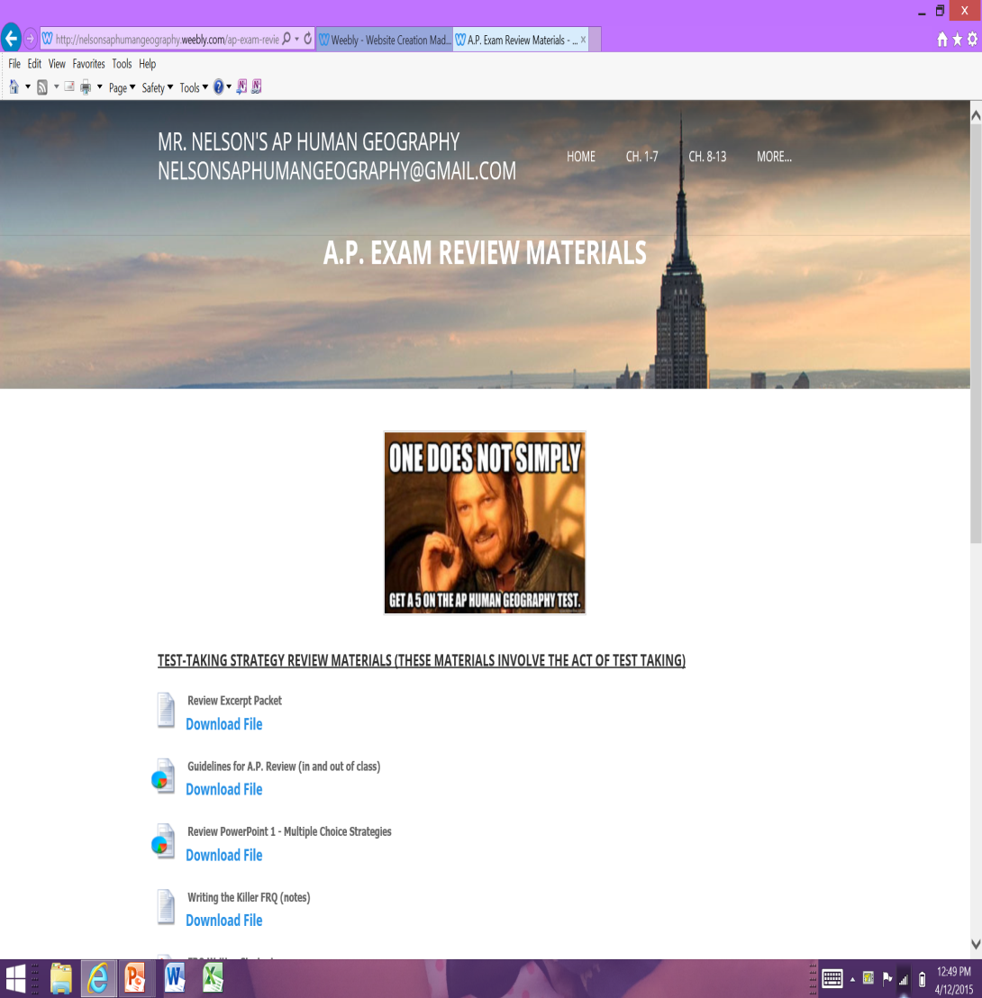
For Tomorrow
Go on the website under the tab “A.P. Exam”
Open the first file, titled “Review Excerpt Packet”
Print out HALF of the packet (about to the reading on page 14 (picture on next slide)

Slide 2
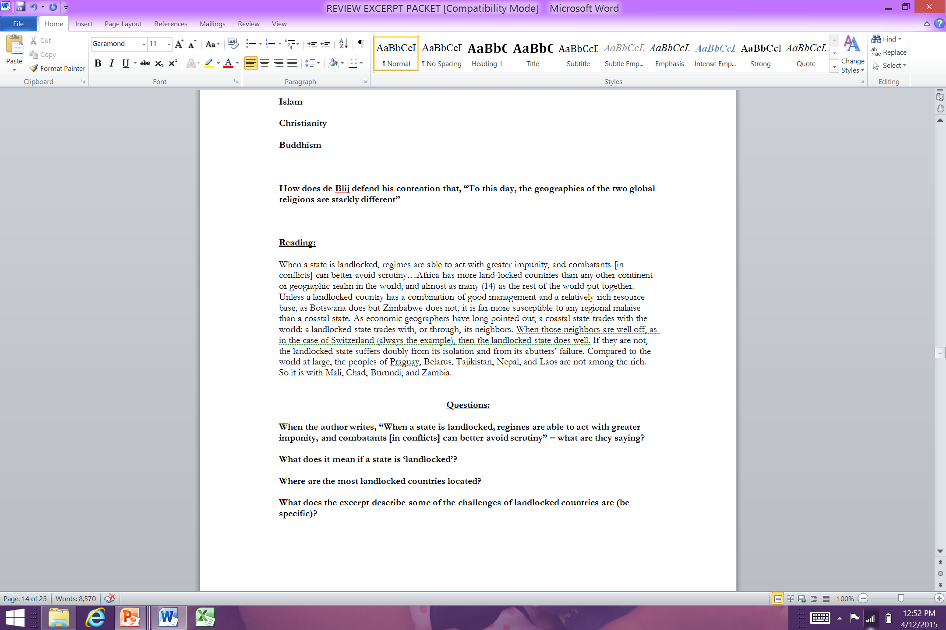
You will have to change the spacing to your own specifications – put as many spaces after each question (questions are bolded) so you have room to write answers/notes in class. After changing the spacing, print out up to this reading (on the original page 14, starting with “When a state is landlocked…”)

Slide 3
Some Info about the A.P. Exam
The A.P. exam (2015) is Friday, May 15th, at 8:00am – 25 classes nd 32 calendar days from now (*this is the last day of the 2-week A.P. exam schedule - *AP World is the day before and APUSH is the Tuesday before.
If you have not yet brought in your final payments, please do so asap and bring to main office.
I will have food/coffee in this room (208) around 6:45/7:00, prior to the test
A little before 8:00am you will go to whatever room you are assigned (I will have this information closer to the exam) – you can bring nothing but water and pencils/pens
The exam is not proctored by teachers, and I am not allowed to communicate/visit during the test.
If this is your first A.P., you’ll spend a few minutes prior to the test filling out some demographic information (age, sex, race/ethnicity, etc.)
The test itself is 2 hours & 15 minutes (60 minutes for part 1 and 75 minutes for part 2) – you cannot go back to part 1 after you’ve completed it.
Once the test is over you will be expected to go to the remainder of your classes (unless you have another exam) *

Slide 4
Resources & How To Use Them
There are a lot of resources for this course (perhaps too many) – so how to study appropriately can be daunting, so let me make a few suggestions.
Identify what you need more work on – at this point you should know if you understood Migration better than you did Urbanization – study accordingly. Time is a scare resource, and must be used intelligently, rather than spending equal time on everything.
Identify the resources that you find the easiest to understand. If you find the Review book easier than the text, use the Review book – I’d still reference other sources, but don’t try to sit with 3 review books, my PowerPoints, your textbook, and your notes at once!
Consistency – it’s less about how much you study than how you study. I recommend a little bit each day over the course of review, rather than waiting till the weekends to cram – this is a bad strategy.

Slide 5
What In-Class Review Will Look Like:
Focus – 20 classes isn’t as long a it seems – expect to be called on, expect to stay focused in class – and expect to ask questions…
Active vs. Passive Review – there is a lot of research that suggests that the more active you are in your own learning, the more you retain. If you have a question, ask it! If you feel insecure doing this in class, email me, or come see me on an off period – but if you don’t understand a concept, and it doesn’t come up in review, you’ll continue to struggle with it – you have to be active in this process, one way or the other!
Notes: We will be reading and annotating our review packet a lot – please take notes in addition to our definitions and ask questions.

Slide 6
Contact Information
I need a contact email that you actually use/check – and you will be responsible for checking this email daily. If I send out a notification on here you are expected to have read it.
I will also put things on Twitter (@nelsonshumangeo)

Slide 7
Reading Packets
This will be our primary resource as we review – we’ll go over multiple choice questions and frq’s but largely this will be our review of the curriculum.
You will be expected to had read and filled out the questions I ask you to before coming to class. If I call on you for an answer and you don’t have it because you didn’t do it, you’ll stall the entire class, and take away from everyone’s review time (which we all need) – so please don’t be that person!
I will tell you which readings you will be responsible for at least 1 day before we do them in class (if not more) – you are responsible to each other, so please do them.

