Slide 1

Mr. Nelson – APHG
nelsonsaphumangeography@gmail.com (email)
Class Website: http://nelsonsaphumangeography.weebly.com
Welcome to class!
This is a modified (shortened) version of the syllabus on the website.
—Take out your notebooks since you don’t have iPads yet
—Sit anywhere you like (for now)

Slide 2
Today:
1.) AP Courses & their expectations (AP exam, college credit, etc.)
2.) The course itself (policies, grading, note taking, assignments/tests)
3.) The principles of being successful in this (and other AP courses)
4.) Where you signed up or were signed up for class by someone else?

Slide 3
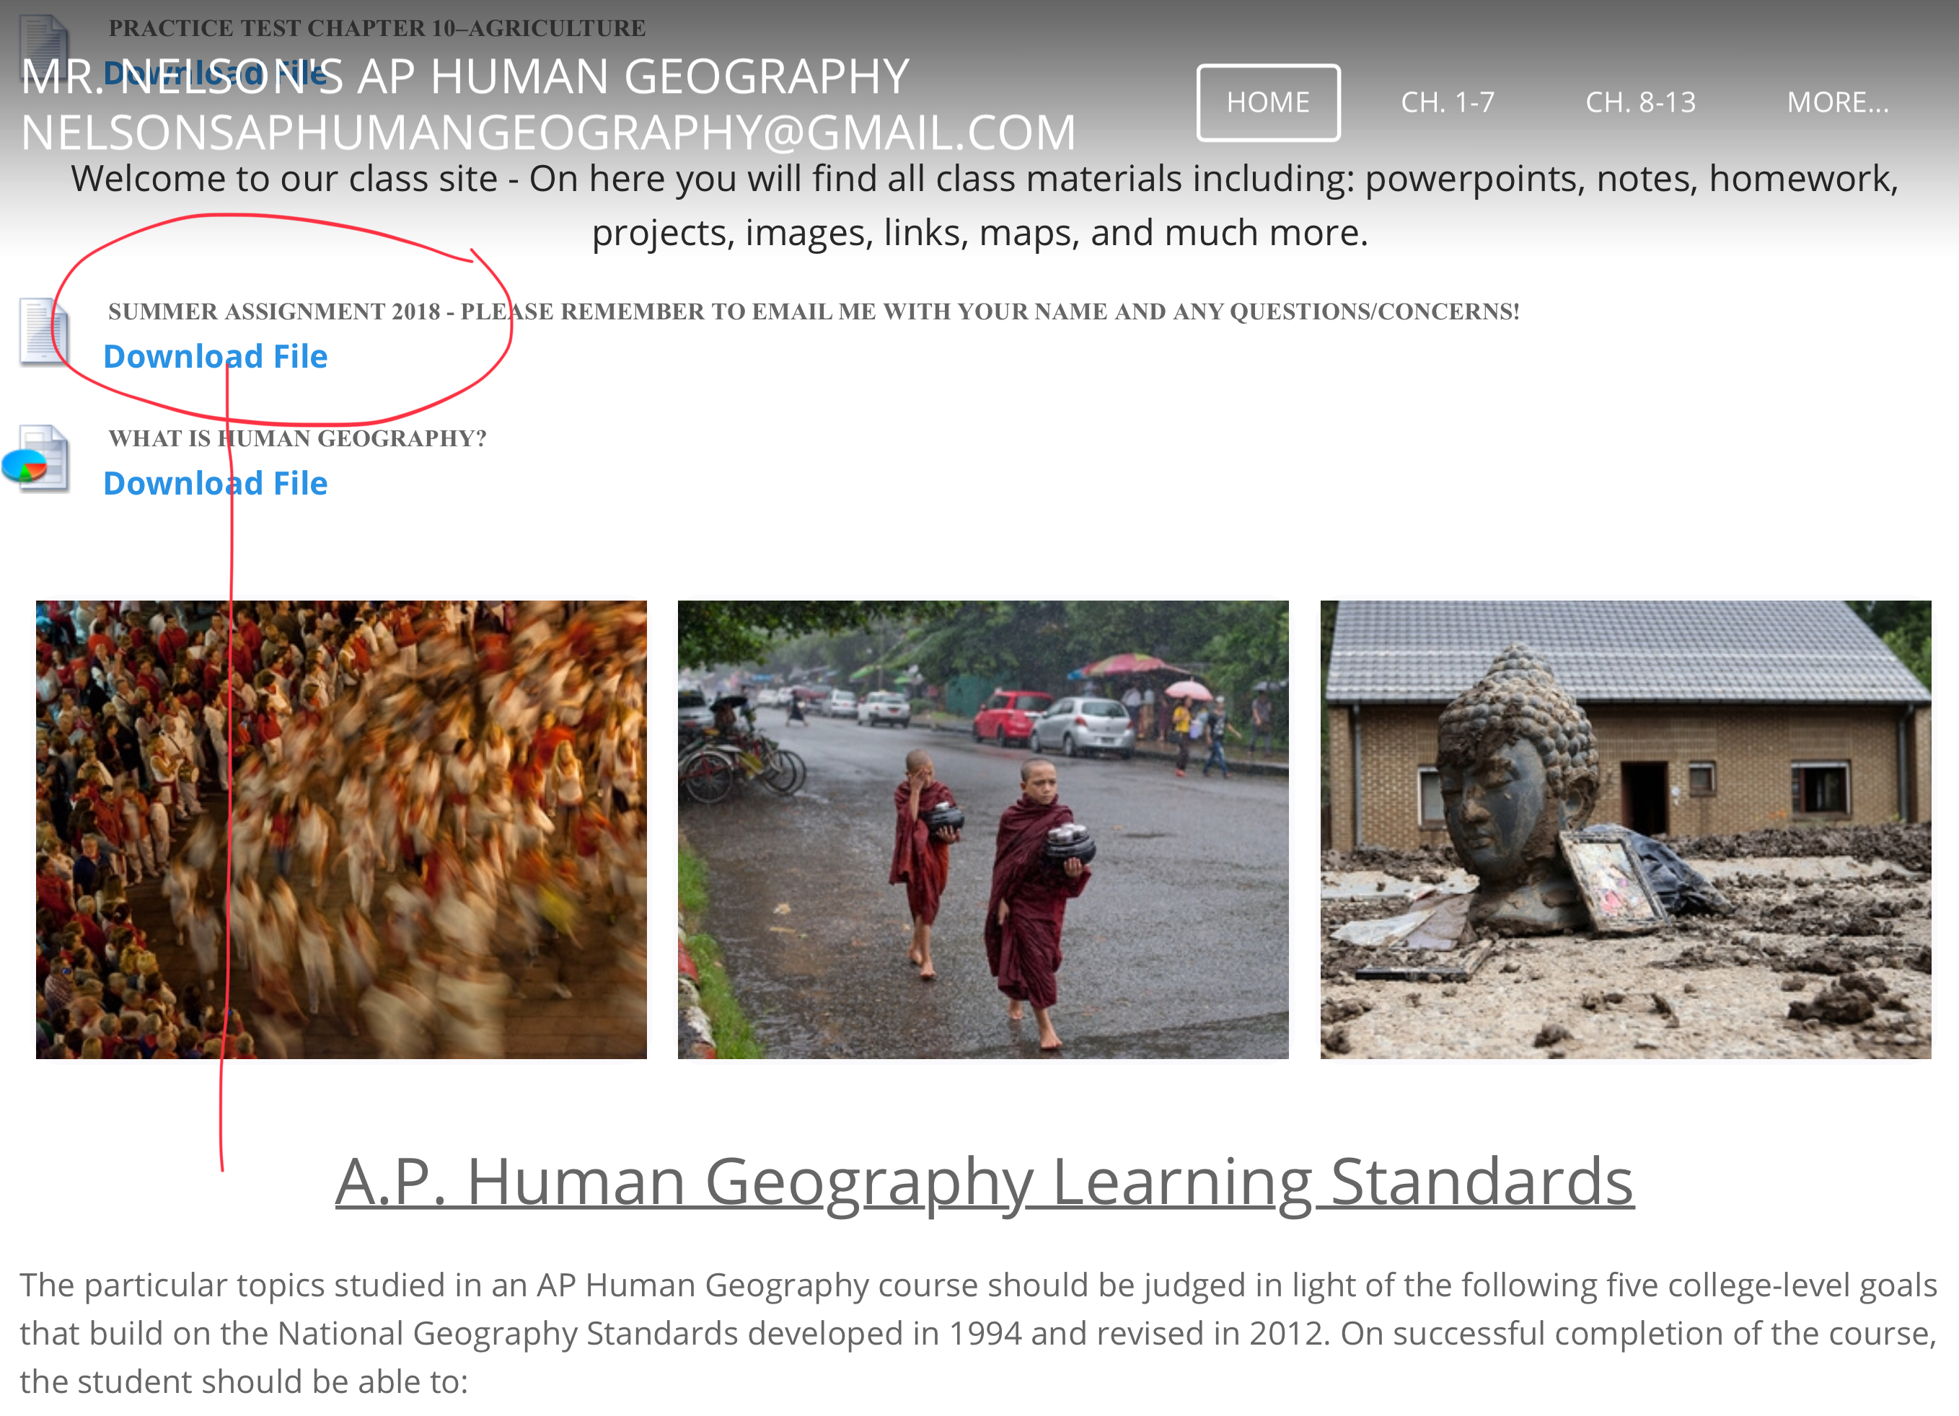
The Summer Assignment
All AP classes (not just this one) have summer assignments (for future reference) *This includes 9A (which most of you are probably in with either Sakowich or Pantorno)
While many of you didn’t realize there was an assignment or when it was due, I’m moving the due date to Friday, November 2nd (or sooner…why?)

Slide 4
iPads and Note Taking
For most of you, how to take notes properly (I’ll explain)will be one of the more challenging parts of this course.
NO—>Direct, word for word copying (why?)
YES—> open PowerPoint we’re doing in class on your iPad (notes are there already)!
WHAT DO DO—> modify the PowerPoint, use a note taking app.
FOCUS ON—>in class examples (things I say, ways I explain, other student examples, etc.)
WHY: a.) There’s too much to copy, it just doesn’t work, b.) Simply memorizing terms isn’t enough in this class, so factual notes that don’t make sense won’t help you.

Slide 5
Review Books and Textbooks
Get a review book asap (Princeton Review, any year is fine. Get it on amazon. It will help, just trust me on this)
Textbooks: We’ll get them next week?
WHAT TO DO: leave home, or in locker. I don’t use either in class, but you will need both for tests and homework.

Slide 6
What is an AP Class and how is it different?
College Credit—AP Exam—>you will all sit for the AP exam in May. It’s scored out of 5 (1 being lowest, 5 highest). A score of 3 or higher will typically grant you 3 college credits (1 class). So, for example, if you get a 4 on AP US History in 11th grade, you will get to skip an introduction to US History course in college. This saves both time and money. The test has a fee (high of $90 dollars, low of $20, depending on your financial situation)
Other differences between AP and Non AP classes—>
Pace
Memorizing facts vs. understanding concepts
Participation
Amount of material
We only have 9 months

Slide 7
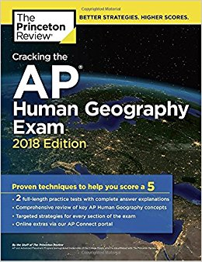
What is the AP exam and how does it work in terms of college credit?
AP Exam is Tuesday, May 14th, 2019 @12:00
75 multiple choice questions and 3 FRQ’s (free response questions). Each section is timed rigidly
They can ask you literally anything that appears in any textbook (there are several), an any review book (also, several).

Slide 8
What’s the difference (in your view) between an advanced class and a non-advanced class?
Work done on your own (not assuming that you’re only responsible for material if you hear it in class)
Working intelligently and not just hard
Studying does not equal reading
Silence in class (usually) equates to poor grades
What do you think the most important skills to posses as a student in this class?
Mastering principles (both of being a student and of the course material itself)
Not stressing yourself out through your own behavior
Keeping a beginner’s mind and not believing the myth of ‘smart’ or ‘not smart’ kids

Slide 9
Expectations – Difference between A.P. courses and others (including some “A” course)
Check your email regularly: There will be many instances where I need to communicate with you all as a single unit – therefore I will be sending class emails from my GMAIL account. You are responsible for receiving these – if I send out a reminder about a test or HW and you don’t check your email that day, please do not complain.
Check the class website regularly
Print out what I ask you to print
No late work
You are responsible for material not directly covered in class! This may be the most important of the 5 bullets here – the primary difference between A.P. and non-A.P. level education is the amount you are responsible for on your own – this is meant to mirror college (for example, if you take Western Civilization 1 in college, the professor does not have bullet points on a slideshow of the entire 1,000 page textbook – you are expected to read on your own and she/he covers whatever they can in class!) I try to be as thorough as possible, but there may be a term/fact here or there that I simply don’t have the time to talk about in class - you are still responsible for reading the text/review book and looking at PowerPoint’s.

Slide 10
So What Do I Do?
Despite any preconceived notions you may have (no doubt based on personal experience as a student for most of your life), a teacher’s role is not to read notes off of a screen to you, nor is teaching the act of repeating the textbook aloud to a room full of people over the course of 9 months. You can all read, and you are all intelligent people – my role is to make the confusing words in the textbook easier to understand, provide examples, clarify confusions, help you with strategies to pass tests, help to build your writing skills, and (perhaps most importantly) help you learn how to learn.

Slide 11

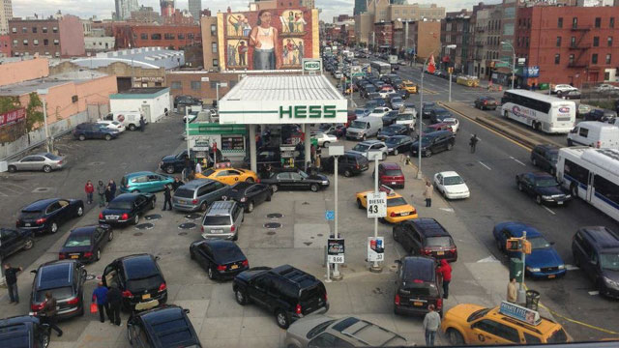
Topic: The “Why of Where” - An Introduction to Human Geography
Aim: How can we best develop a spatial perspective?
Do Now: Where exactly is the Middle East? Why do we call it that?

Slide 12
The terms “Middle East” and “Far East” were in relation to Western Europe (mainly the British Empire) during the 18th and 19th centuries. The correct geographic terms for these places are Southwest Asia and East Asia.
Southwest Asia
East Asia

Slide 13
Developing a Spatial Perspective

Slide 14
The spatial perspective:
Recognizing how human activities are organized
in space and how they relate
to the natural environment.
Notes:
DISCUSSION:
* Re-state this concept in your own words.

Slide 15
“Association Among Phenomena in Places….”
Or…why things are where they are, and how they relate to other things…
Discussion (Spatial Perspective):
Why do you think most pizza places have Chinese take-out places in the same area?
Why are certain shopping malls located on bus routes, while others are not?
Living in New York, why won’t we see many Presidential campaign ads?
Why do we so frequently see Chinese baby girls adopted by American (and typically white) families?

Slide 16
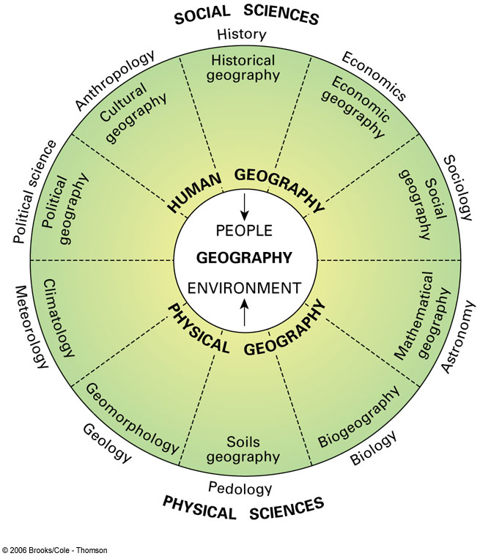
Two Types of Geography:
Physical Geography: The study of where any why natural forces occur as they do (climates, landforms, types of vegetation, etc)
Human Geography: Study of where and why human activities are located where they are (religions, cities, businesses, governments, etc)
Human Geography has a theme of 2 interrelated but converse themes - Globalization and Local Diversity

Slide 17
THE FIVE THEMES OF GEOGRAPHY:
Location
Place
Human-Environment Interaction
Movement
Regions

Slide 18
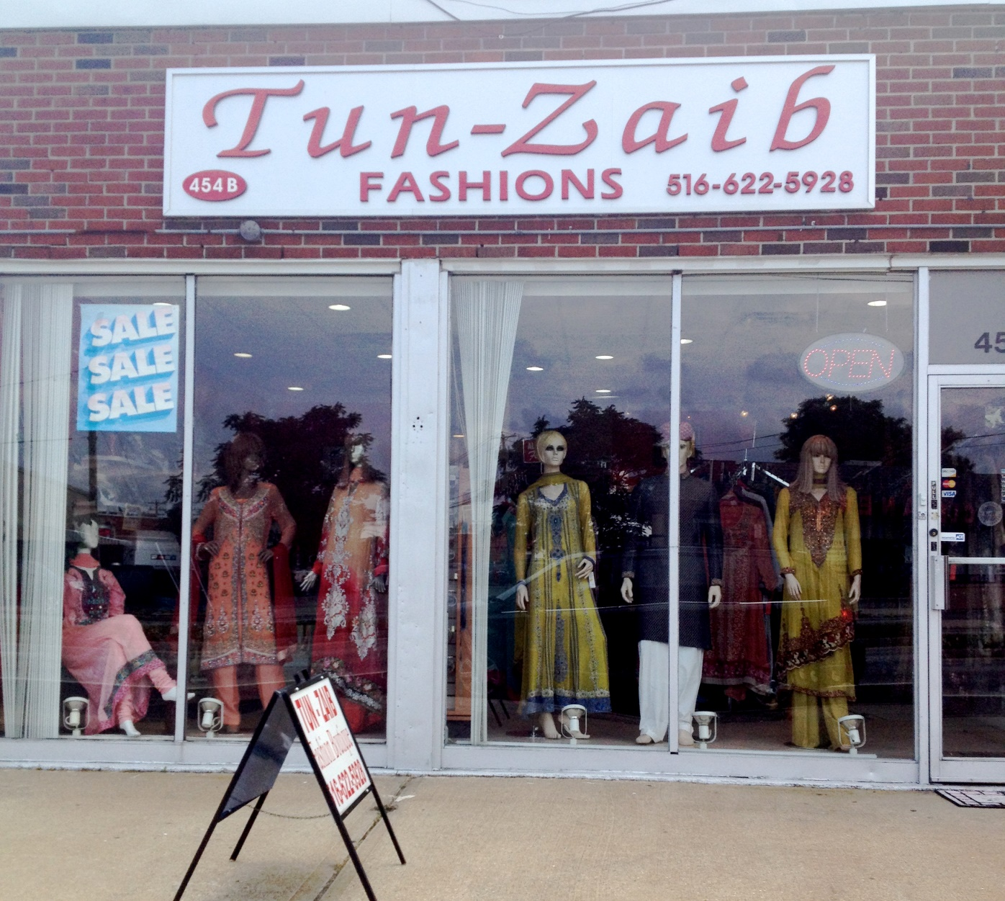
What does this store indicate about the surrounding area? (Hicksville)

Slide 19
Space: Distribution of Features
  Space refers to the physical gap or interval between two objects.
  Geographers think about the arrangement of people and activities in an attempt to try to understand why they are in such a distribution (the arrangement of a feature in space)

Slide 20
Spatial Distribution:-geographers are concerned about the arrangement of features on the earth’s surface. 3 main properties of distribution are:
  Density: the frequency (number of) something occurs in a given space (examples?)
  Concentration or ‘dispersion’: Not how much, but how spread out something is. If close, it’s described as clustered (or agglomerated). If spread out it’s described as dispersed (or scattered).
  Pattern: Refers, like concentration, to pattern, but focuses on design, rather than just spacing.
Notes:
Density is an important issue in Population studies-the number of people per square mile in a country might tell you something about living conditions and living standards.
Concentration-the population used to be clustered or concentrated in the northeast, but it is becoming more dispersed as many people move to the West, Southwest or South.
Many American cities in the West are arranged in square or rectangular patterns because of the Land Ordinance that established this grid pattern in 1785. However, in New England, which was settled well before that time, there is a more irregular arrangement of roads, streets and towns.

Slide 21
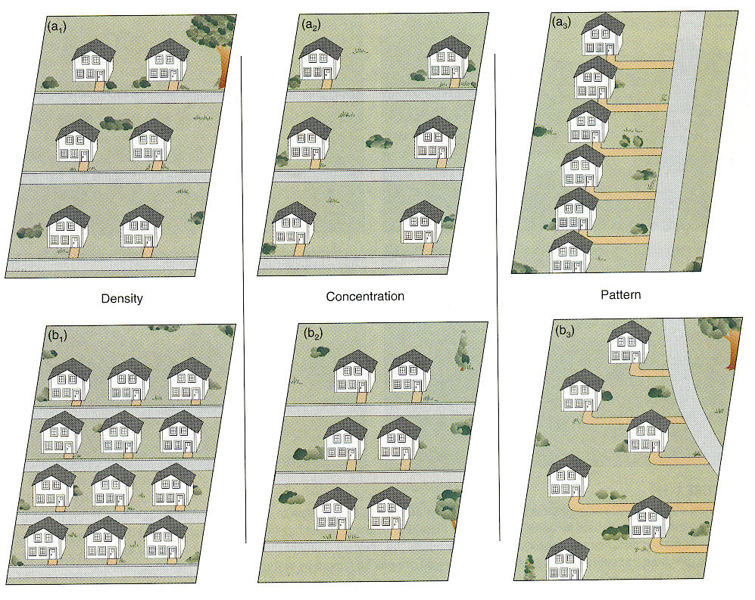
Density-In A we see 6 houses on 1 acre of land. And in B we see 12 houses per acre
Concentration-in A we see the houses dispersed and in B we see them clustered.
Pattern-in A the houses are in a single linear arrangement, in B the arrangement is irregular.
Notes:
Density-In A we see 6 houses on 1 acre of land. And in B we see 12 houses per acre
Concentration-in A we see the houses dispersed and in B we see them clustered.
Pattern-in A the houses are in a single linear arrangement, in B the arrangement is irregular.

Slide 22
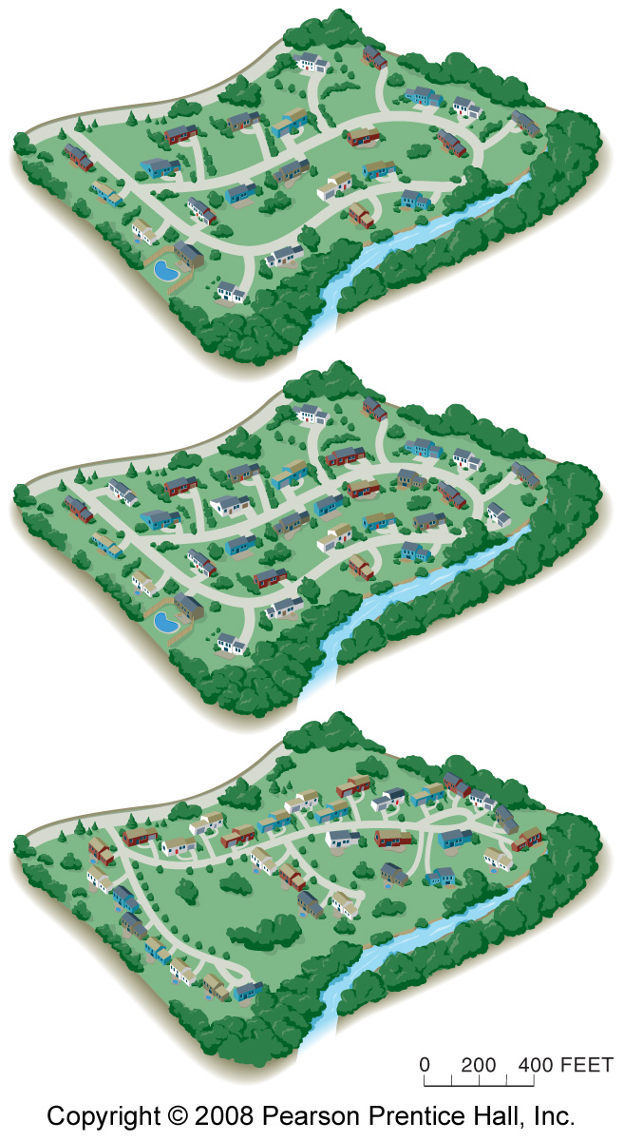
The top plan for a residential area has a lower density than the middle plan (24 houses compared to 32 houses on the same 82-acre piece of land), but both have dispersed concentrations. The middle and lower plans have the same density (32 houses on 82 acres), but the distribution of houses is more clustered in the lower plan. The lower plan has shared open space, whereas the middle plan provides a larger, private yard surrounding each house.

Slide 23
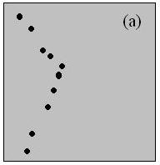
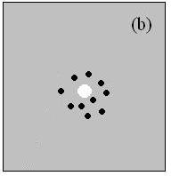
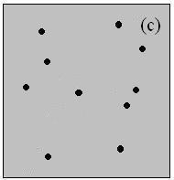
Types of Pattern:
Linear Patterns typically depict houses along a street or towns along a railroad
Centralized Patterns typically involve items concentrated around a single node. Ex: Center City with surrounding suburbs
Random pattern: An unstructured, irregular distribution

Slide 24
Standard 2: Human Geography
Understand and Interpret Implications of Associations Among Phenomena in Places:
Geography looks at the world from a spatial perspective -- seeking to understand the changing spatial organization and material character of Earth's surface. One of the critical advantages of a spatial perspective is the attention it focuses on how phenomena are related to one another in particular places.

Slide 25
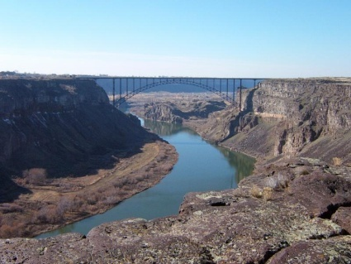
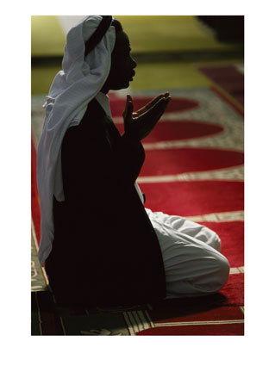
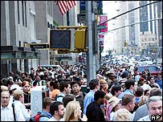

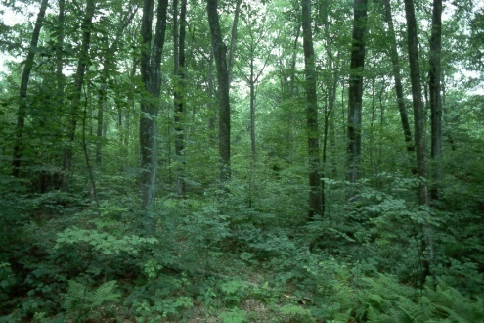
PLACE
What is it like there, what kind of place is it?
Human Characteristics
    What are the main languages, customs, and beliefs.
    How many people live, work, and visit a place.
Physical Characteristics
    Landforms (mountains, rivers, etc.), climate, vegetation, wildlife, soil, etc.

Slide 26
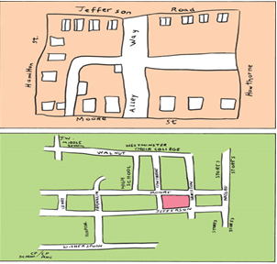
Mental Map Homework (due Friday)
You will draw your own mental map of the world on a blank sheet of paper. This map should NOT be perfect, it is just a pretest of your knowledge at the start of the semester. YOU CAN’T LOOSE POINTS FOR INACCURACY, SO PLEASE DO NOT REFERENCE ANY ACTUAL MAPS TO HELP YOU!
List 5 physical features like mountains, rivers, lakes,
List 5 political features such as cities and countries.
List 5 economic features like natural resources, trade goods.
List 5 scientific/ technological features like inventions and ideas, or innovations
List 5 cultural features; works of art, literature, music, religions.
List 5 migration streams across space (any time, use arrows to indicate place of origin).

Slide 27
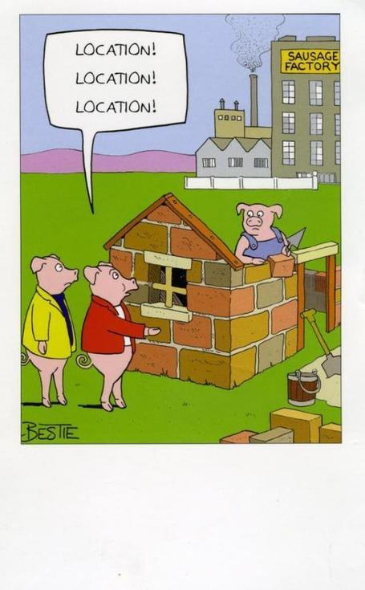
Place: a unique location on Earth-examples include your hometown, a vacation destination, or a part of a country.
Can be described in 4 ways:
Place name (Toponym)
Site
Situation
Mathematical location
Notes:
27
Examples of place include hometown, vacation destination, part of country

Slide 28
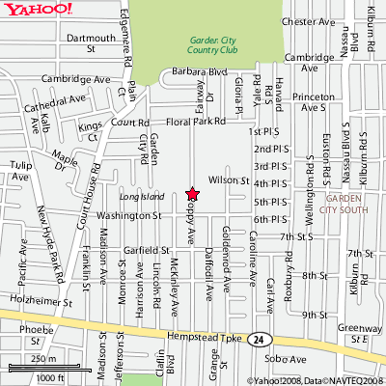
Toponym: name given to a place on Earth. Can be named after a person, a religion, resources, or features of physical environment
Toponymy is the scientific study of place-names, along with their origins and meanings, based on etymological, historical, and geographical information
H. Frank Carey High School

Slide 29

Bolivia – Simon Bolivar
Colombia – Christopher Columbus
America – Amerigo Vespucci
Philippines – King Philip II of Spain
Washington, D.C. – George Washington
Georgia (US) – King George of England
Baltimore – Lord Baltimore
Vietnam – Ho Chi Minh City- (Self Explanatory)

Slide 30
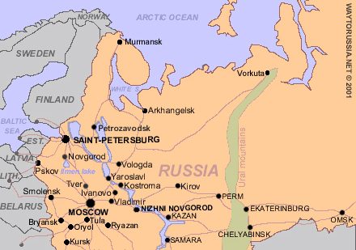
Reflects political changes…
St. Petersburg
Petrograd
Leningrad
St. Petersburg
Changed to Petrograd in 1914 because Russians thought St. Petersburg sounded too German. Renamed Leningrad in 1924, 3 days after Lenin’s death. Renamed St. Petersburg in 1991 after the collapse of the Soviet Union.
Notes:
30
Changed to Petrograd in 1914 b/c Russians thought St. Petersburg sounded too German. Renamed Leningrad in 1924, 3 days after Lenin’s death. Renamed St. Petersburg in 1991 after the collapse of the Soviet Union.

Slide 31
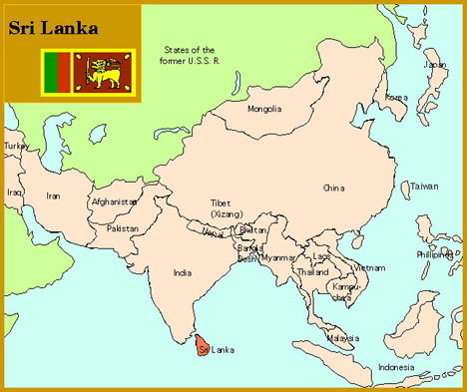
Imperialism/Changing influences…
Serendib -> Ceylon -> Sri Lanka
The Arab name for Sri Lanka was Serendib, from which we get the word serendipity. Ceylon comes from the word which the Portuguese used for the island -- Ceilao. After 1972, the island came to be officially known as Sri Lanka. “Lanka” means island is Sanskrit.
Notes:
31
The Arab name for Sri Lanka was Serendib, from which we get the word serendipity. Ceylon comes from the word which the Portuguese used for the island -- Ceilao. After 1972, the island came to be officially known as Sri Lanka. “Lanka” means island is Sanskrit.

Slide 32
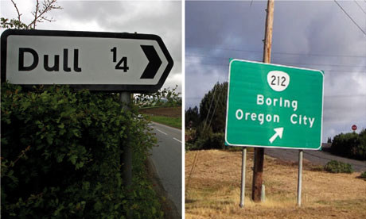

Slide 33
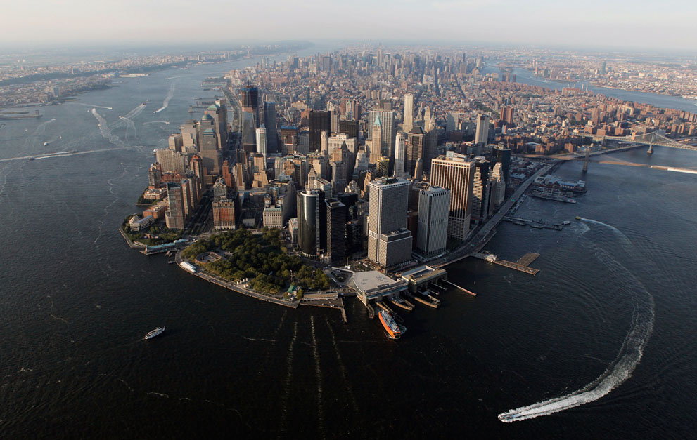
Describe what you see in this picture:

Slide 34
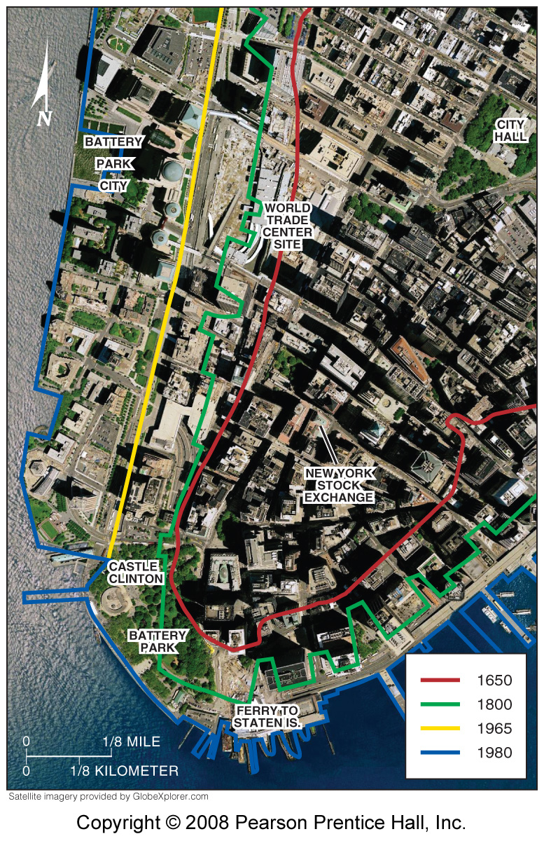
Site: is the physical character of a place. Includes climate, water sources, topography, soil, vegetation, latitude, and elevation.
Site of lower Manhattan Island, New York City. There have been many changes to the area over the last 200 years.

Slide 35
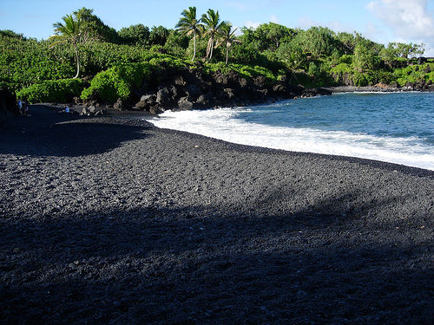
Black sand beaches in Hawaii - part of the site
Notes:
35
Black sand beaches in Hawaii

Slide 36
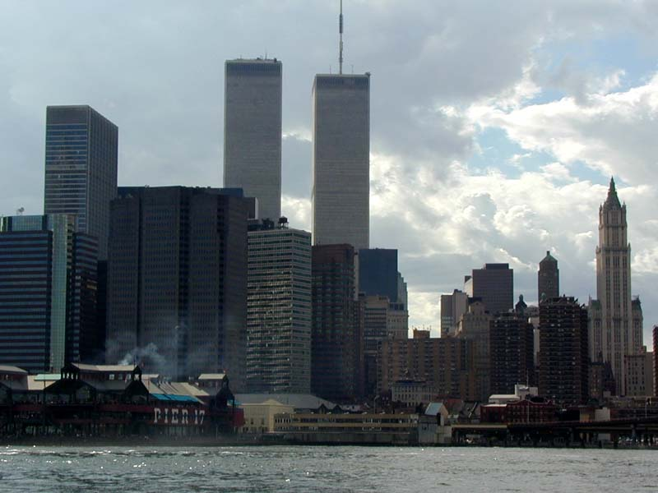
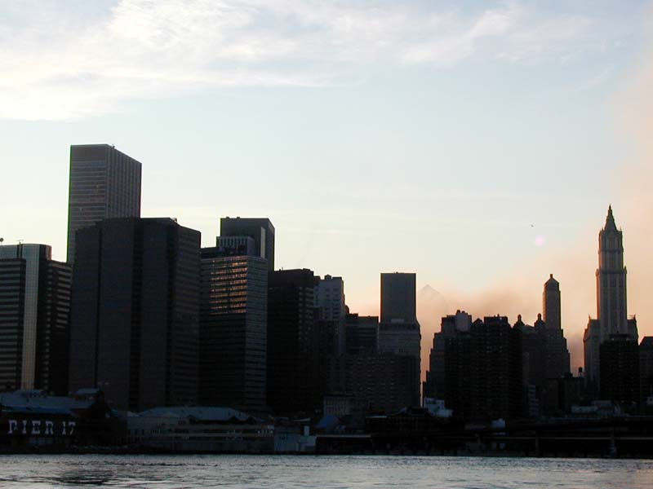
Example of a Change in Site: New York City skyline with and without the Twin Towers
Notes:
36
New York City skyline with and without the Twin Towers

Slide 37
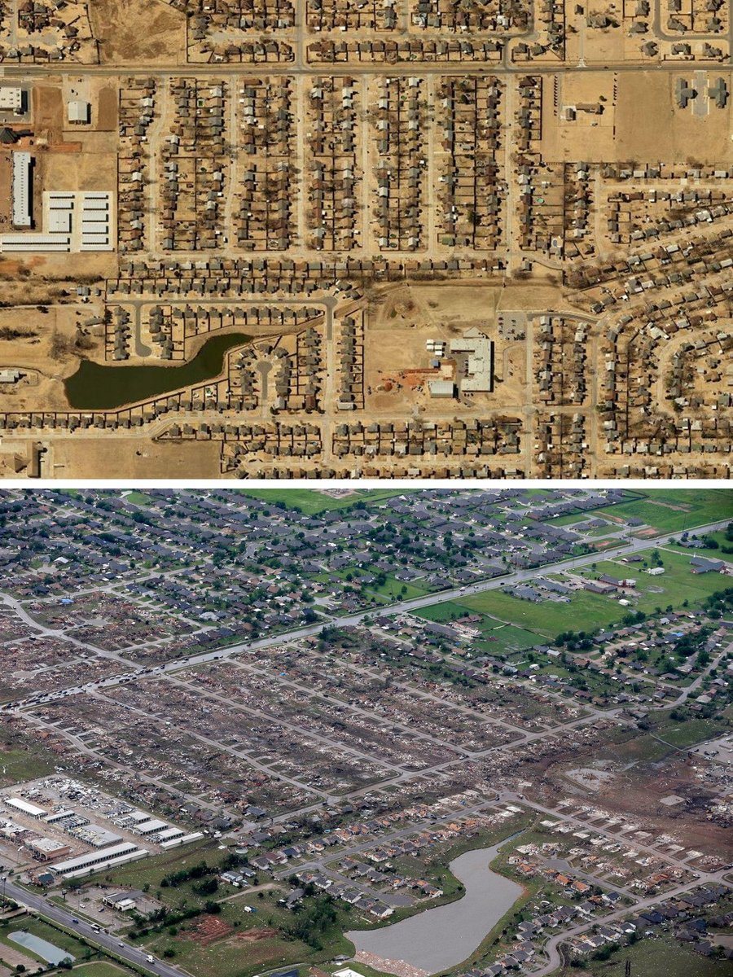
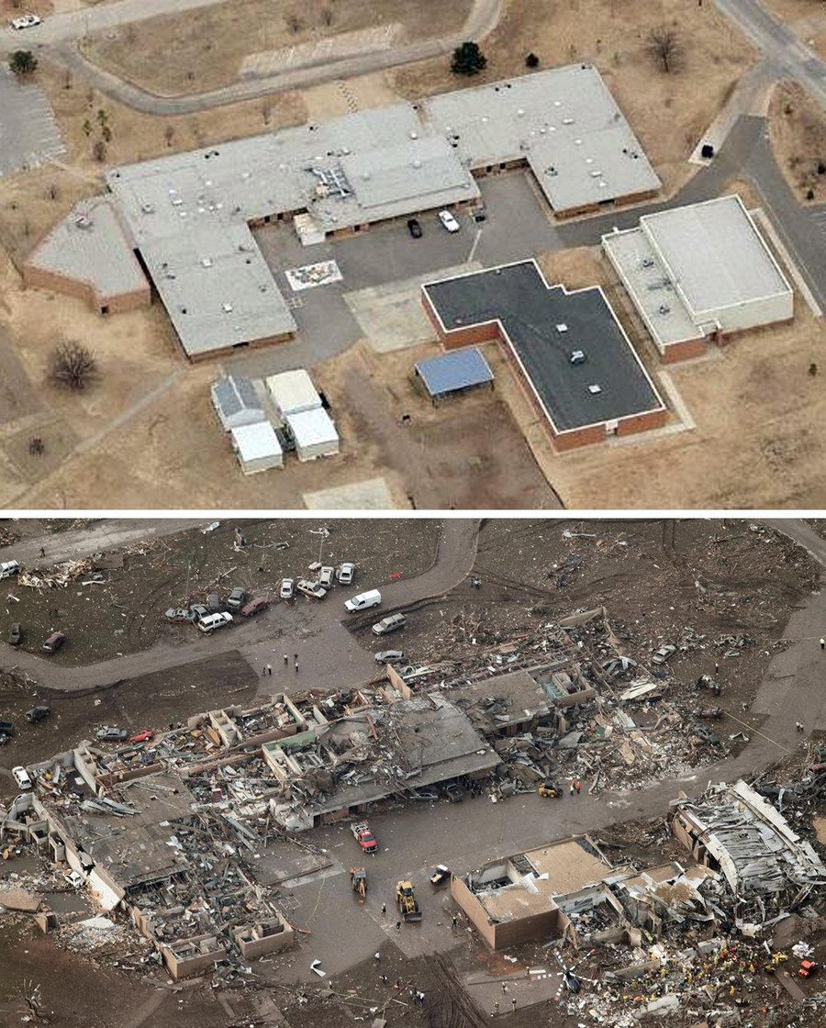

Slide 38
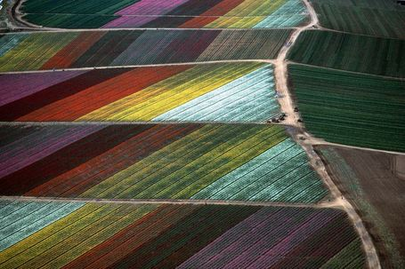
A Cut Flower Field in California: http://cnnphotos.blogs.cnn.com/2013/04/17/exploring-farms-from-above/

Slide 39
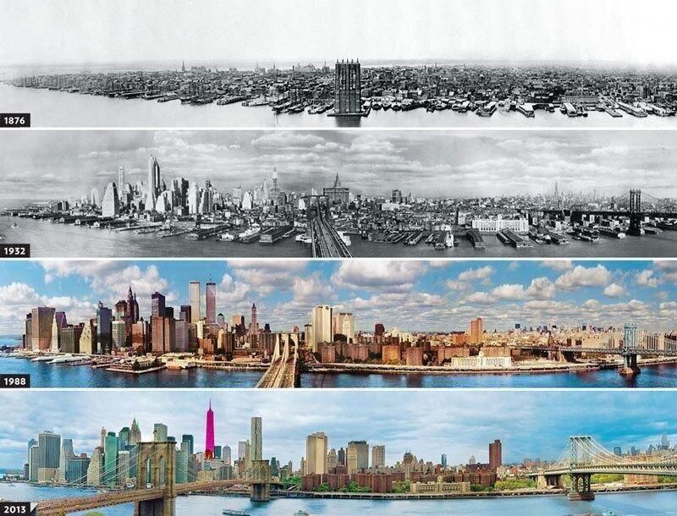

Slide 40

Excuse me, how do you get to…
I need a volunteer to give me directions from this school to your favorite place to eat around here…can be anywhere….

Slide 41
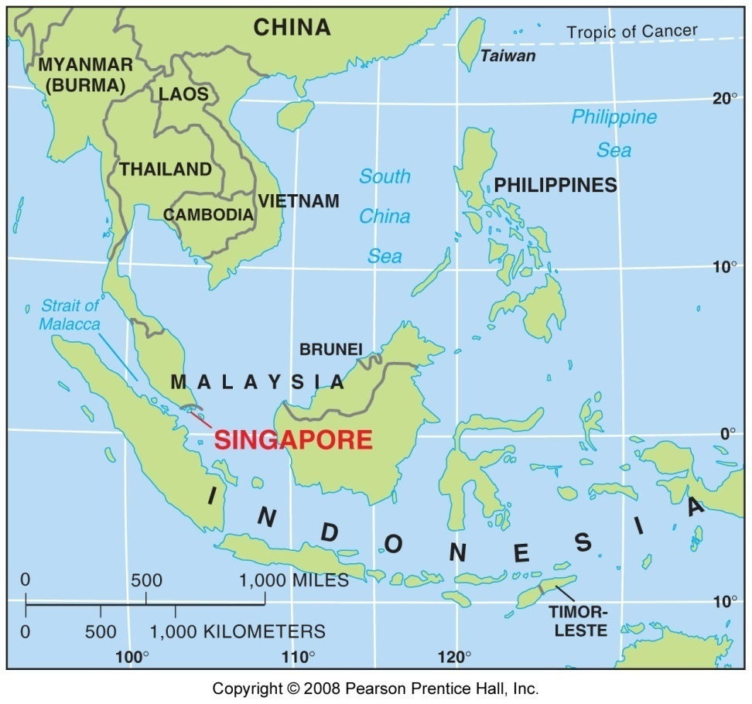
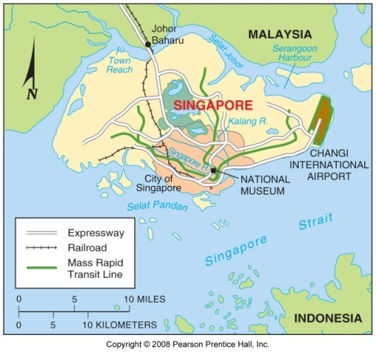
Situation (relative location):
  Situation, or relative location, is the location of a place relative to other places. Situation helps us find an unfamiliar place by comparing its location with a familiar one. Situation, also, helps us understand the importance of a location.
Fig. 1-7: Singapore is situated at a key location for international trade.
Notes:
41
Insert a picture of one of the geographic features of your country.

Slide 42
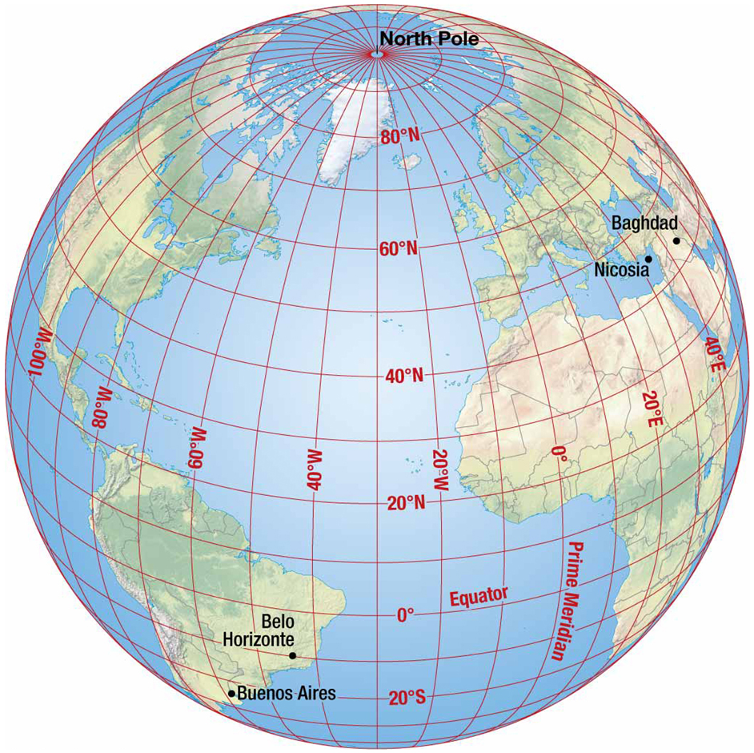
Mathematical Location:
Description of location described mathematically by meridians and parallels, two sets of imaginary arcs
Meridians are arcs drawn between North and South poles. Numbering system of meridians called longitude. The prime meridian is 0 degrees longitude. All other meridians measured East to West of Prime Meridian
A parallel is a circle drawn around the globe parallel to the equator at right angles to meridians. Numbering system called latitude
Notes:
42
Insert a picture illustrating a season in your country.

